Slide 1

Magic Kingdom Guest Entrance System

Slide 2

Disney's Magic Kingdom
The theme park averages roughly 53,000 guests per day
The guests' parking lot is located a mile and a half away from the Magic Kingdom entrance since the land south of the park was initially a swamp
Multiple modes of transportation (ferry, monorail, bus, minnie van) are used to transport guests to the entrance of the park
Extensive wait time is a problem that may affect the quality of the overall guest experience while also imposing potential safety concerns

Slide 3
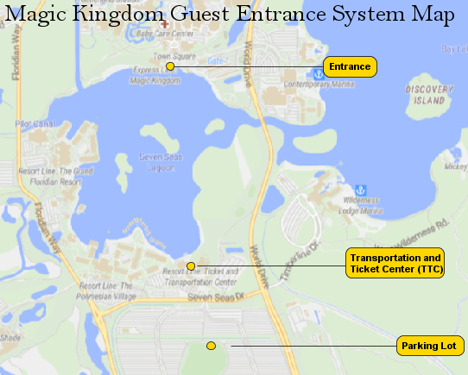

Slide 4
Magic Kingdom Guests Entrance System
A model was constructed in AnyLogic to simulate guest arrivals into the park
It is an attempt to evaluate issues related to extensive wait times for the offered modes of transportation
The system model was broken into two portions: pedestrian movement and transit

Slide 5
Objectives of the Simulation
We are interested in investigating and identifying:
Which mode of transportation is the fastest method to get to the TTC to the park entrance of Magic Kingdom?
Does the design of the TTC create bottlenecking?
Does it lead to unnecessary wait times that can lead to negative experiences for their guests?

Slide 6
Pedestrian Portion of the model:
Object Diagram
(TTC)

Slide 7
Transit Portion of the model:
Object Diagram

Slide 8
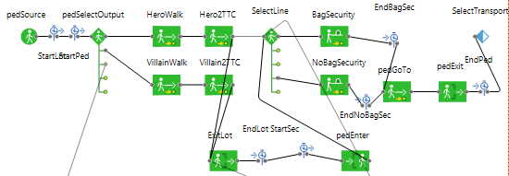
Pedestrian Portion of the model:
AnyLogic

Slide 9
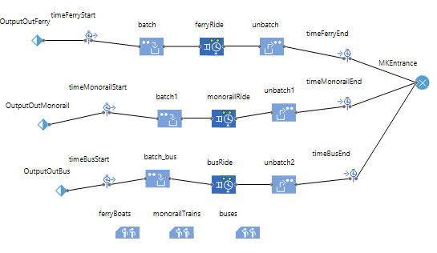
Transit Portion of the model:
AnyLogic

Slide 10
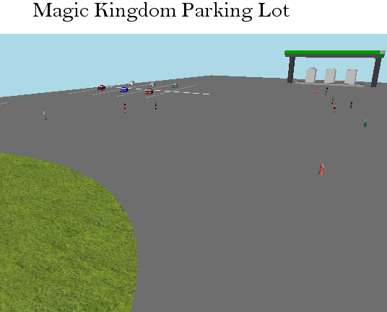

Slide 11
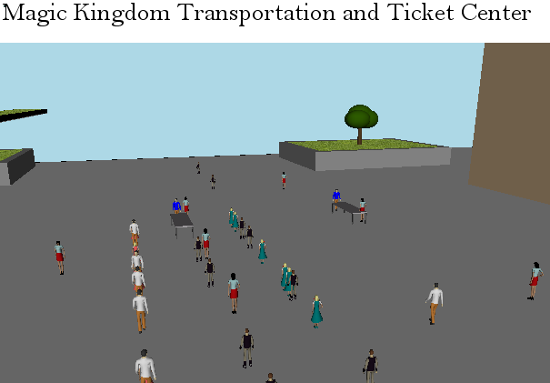

Slide 12
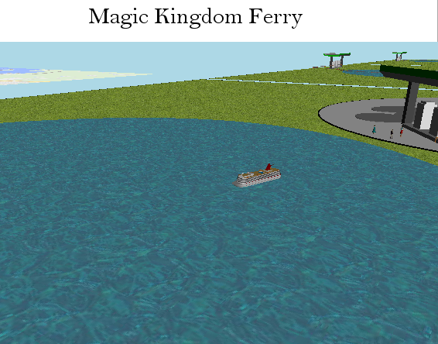

Slide 13
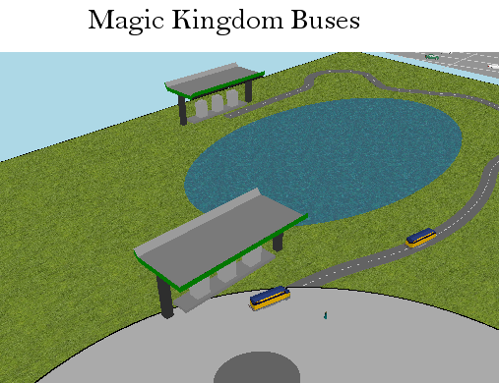

Slide 14
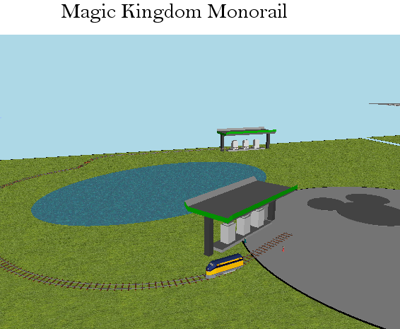

Slide 15
Example of Using the Model
What if more guests chose to ride the monorail and ferry as opposed to the bus?
We initially assumed the likelihood of guests riding any of these modes was equal (ferry = 0.33, monorail = 0.33, bus = 0.33)
These estimates were changed and the model was run again (ferry = 0.3, monorail = 0.5, bus = 0.2)

Slide 16
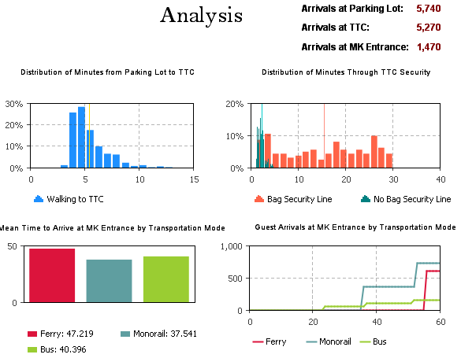
Equal

Slide 17
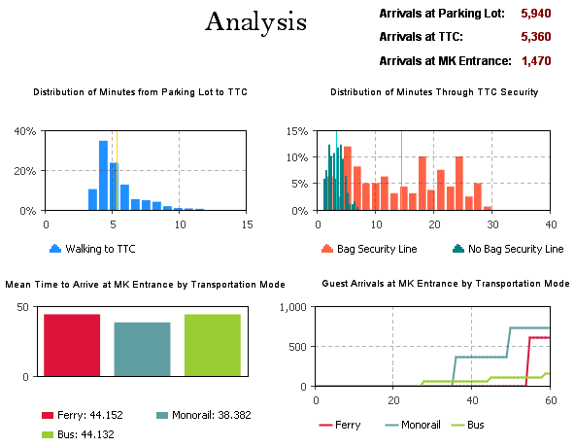
Unequal

Slide 18
Challenges
Pedestrian modeling in AnyLogic Personal Learning Edition is limited to 1 hour of simulation time
The system was fairly complex, so model resolution and fidelity had to be sacrificed (i.e. lot trams were excluded, pedestrian walking from security line to transportation line)

Slide 19
Future Work

